Slide 1
Not all Vocal Tracts are equal; but some are more equal than others
Catherine Watson
With thanks to Kalyan Chilukuri, and Helen Searle

Slide 2
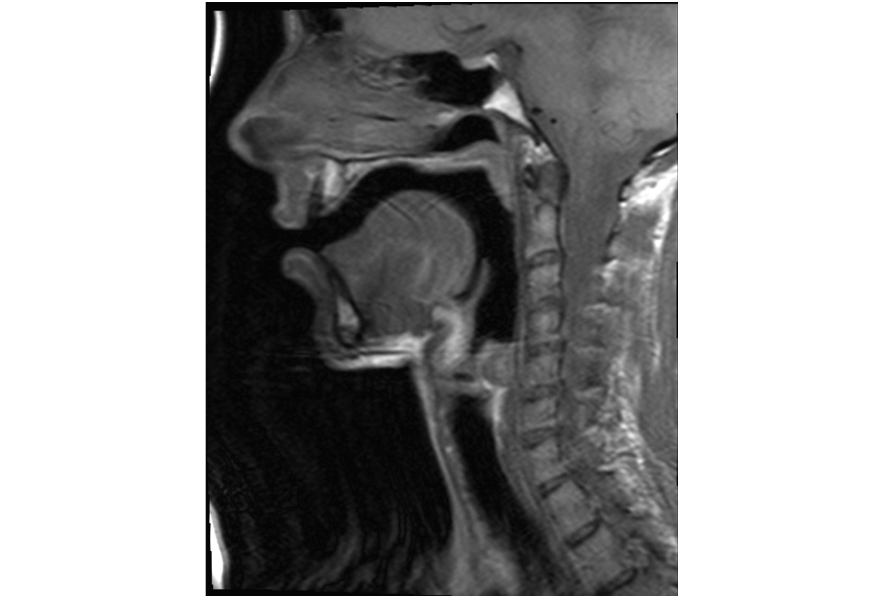
The Vocal Tract
Nasal cavity
Velum
Oral cavity
Lips
Glottis
Tongue
Jaw

Slide 3
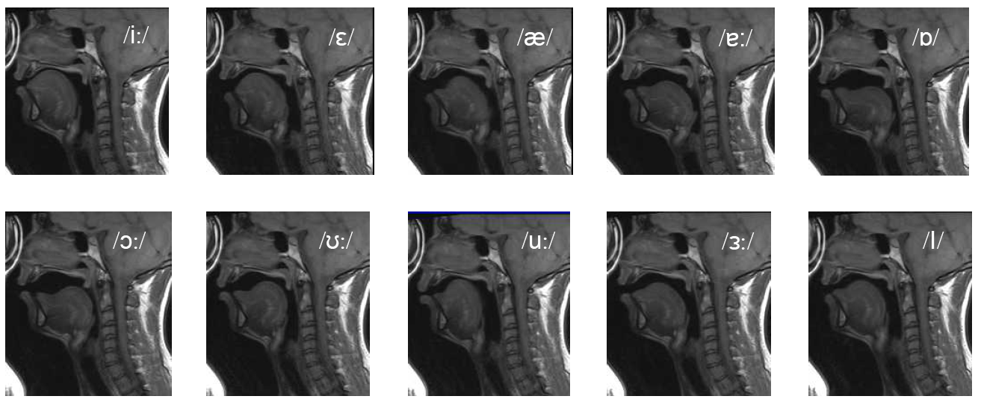
Mid-saggital cross-sections

Slide 4
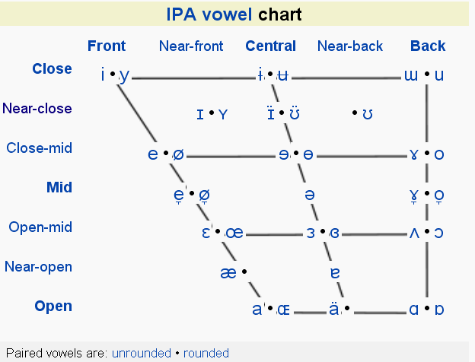
Phonetic representation of vowels

Slide 5
Phonetic representation of vowels
HEED
HOARD
HID
HEAD
HAD
HARD

Slide 6
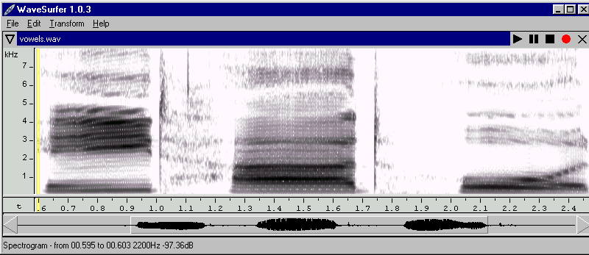
Spectrogram of some vowels
Heed Hard Hoard

Slide 7
Formant Analysis
It is possible to distinguish between any two vowels by the first two formants (F1 and F2) in their spectra.
The F1 is inversely correlated with jaw height, and F2 is inversely correlated with tongue frontness.
Thus plots F1 vs F2 show how vowels can differ both acoustically and in terms of articulation.
Adapted from Watson, Harrington
and Evans (1998)

Slide 8
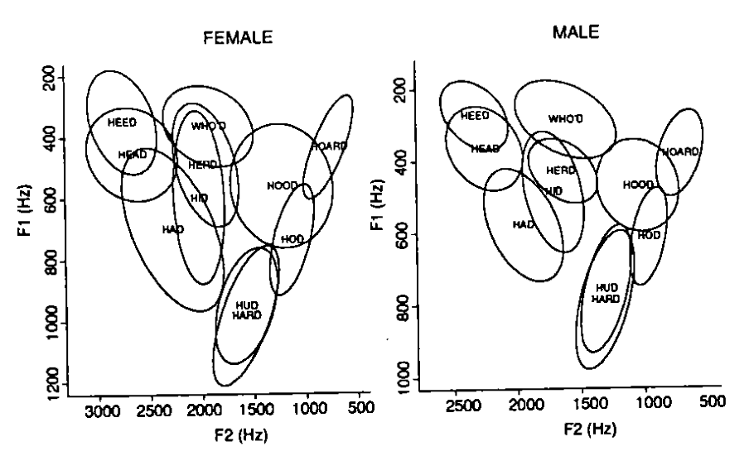
New Zealand English

Slide 9
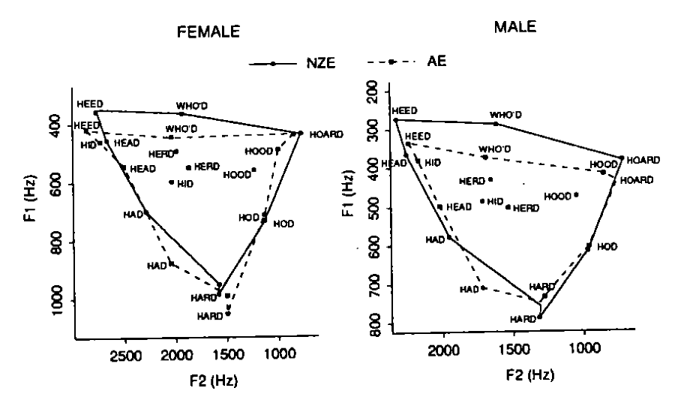
Australian and New Zealand English

Slide 10
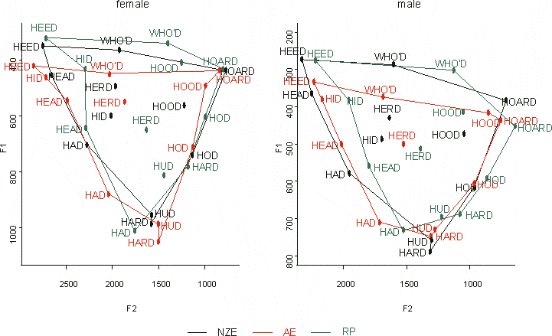
Vowel spaces for New Zealand English, Australian English and Received Pronunciation
Watson, Harrington, and Maclagan,1998

Slide 11
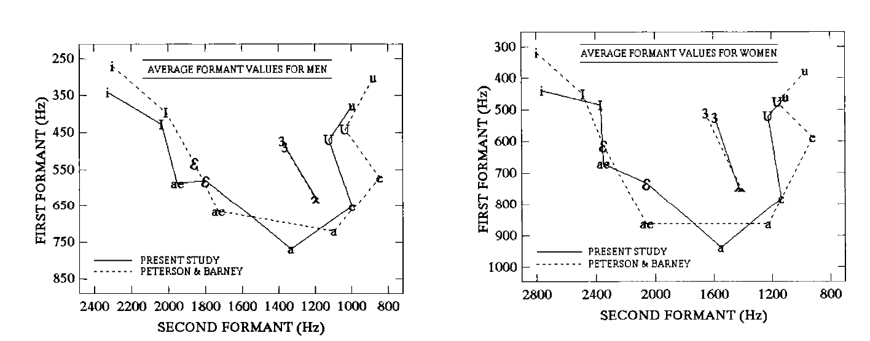
American English
(Hillenbrand et al 1995)
i-HEED, I-HID, ɛ-HEAD, æ-HAD, ʌ-,HUD, a-HOD, ɔ-HOARD, ʊ-HOOD, u-WHO’D, З-HERD

Slide 12
NZE vs. AmE
i-HEED, I-HID, ɛ-HEAD, æ-HAD,
ʌ-,HUD, a-HOD, ɔ-HOARD,
ʊ-HOOD, u-WHO’D, З-HERD

Slide 13
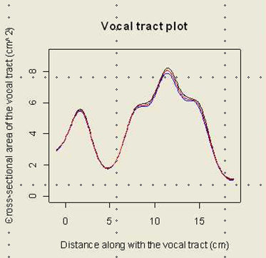
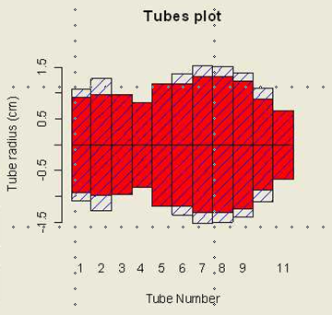
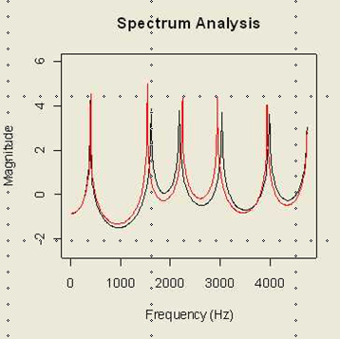
Acoustic Tube Model of the vocal tract
Obtain the cross-sectional
area of the vocal tract
Represent it as a series
of loss-less acoustic tubes
of varying diameter, but equal
width
Find the resonances
of the acoustic tube.
First two resonances
are strongly related to
the vowel formants

Slide 14
Comparison of NZE and American English vocal tracts

Slide 15
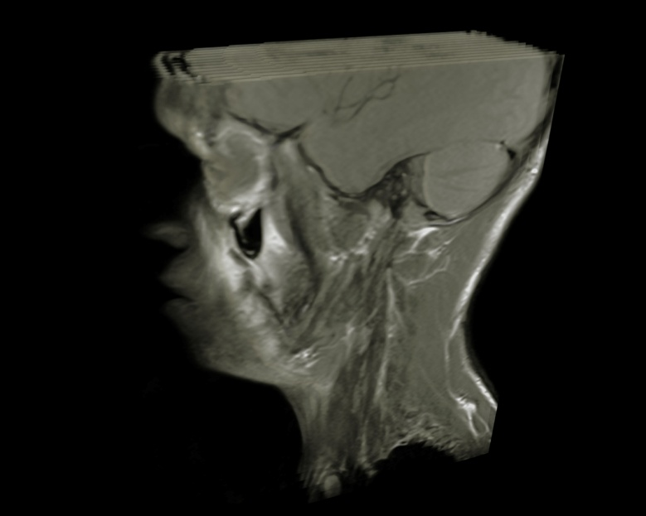
NZE Vocal Tract Analysis using MRI
4 MR images were acquired with a 1.5T Siemens Magnetom Avanto MRI scanner in 2010 and 3 with the 3T version in 2011
7 NZE speakers (2 20-25 yrs, three 40-50 yrs, two 65+ yrs)
The scans were done in parallel sagittal planes, each slice was 6mm, with no gaps and the images were T1-weighted.
Speakers pronounced sustained vowels in “hVd” context: ie HEED, HID, HEAD, HAD, HARD, HUD, HOD, HOARD, HOOD, WHO’D,HERD.
Each vocal tract shape took ~15 second to acquire, and each vowel had 13 slices.
All participants were supine.
Thanks to Robert Bowmaker
for the image.
Notes:
Participants instructed to say vowels in an hVd frame, but sustain the production of the vowel.
Scanning time per vowel
24 sec for M woman, and 15 sec for Y man
Two images per vowel type obtained
All 11 monophthongs.
Participants are supine.

Slide 16
American English MRI Data
Obtained from MRI studies by Story et al, published in 1996,1998 and 2008 respectively.
  1 man (done twice, 1994, 2002) 1 woman (1998)
  MRI Lateral slices 5 mm apart
  Images took 4 mins to acquire
  10 vowels said in isolation, (vowels in “HEED”,”HID”,”HEAD”,”HAD”, ‘HUD”,”HOD”,”HOARD” “HOED”,”HOOD”,’WHO’D”, sound in “HERD” not considered a traditional vowel”
Data presented in tables of cross-sectional area vs. distance (the message used to obtain the cross-sectional areas different than approach we took).

Slide 17
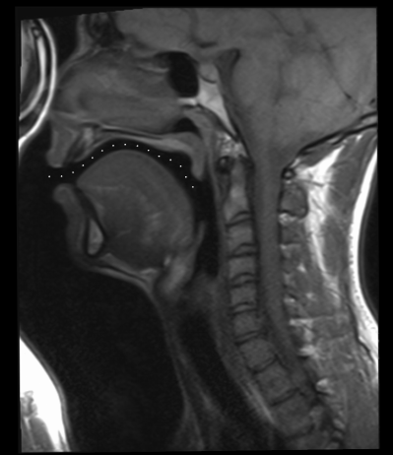
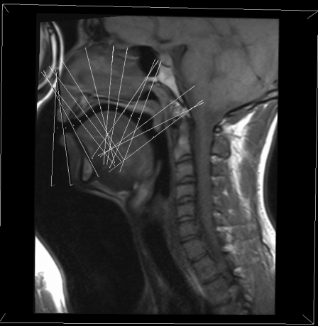
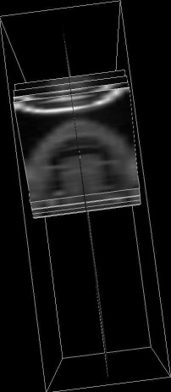
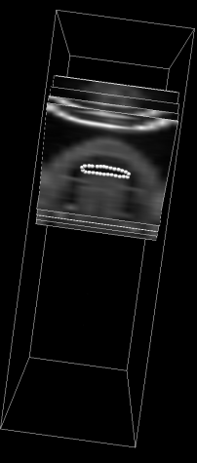
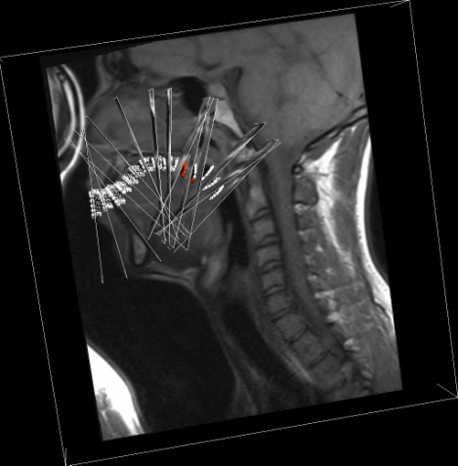
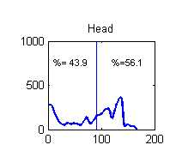
Obtaining the vocal tract data using CMGUI
1. Identify the vocal tract
mid-line
2. For each node obtain plane
Perpendicular to the centre line .
3. Mark out the
vocal tract
5 Calculate the
area of each segment
(perl script)
Repeat steps 1-5
for the pharyngeal
cavity
7. Combine oral and pharyngeal
data, for plot of cross-sectional
areas from lips to glottis
4. Repeat steps 1-3 for each of
the 15 planes in the oral cavity

Slide 18
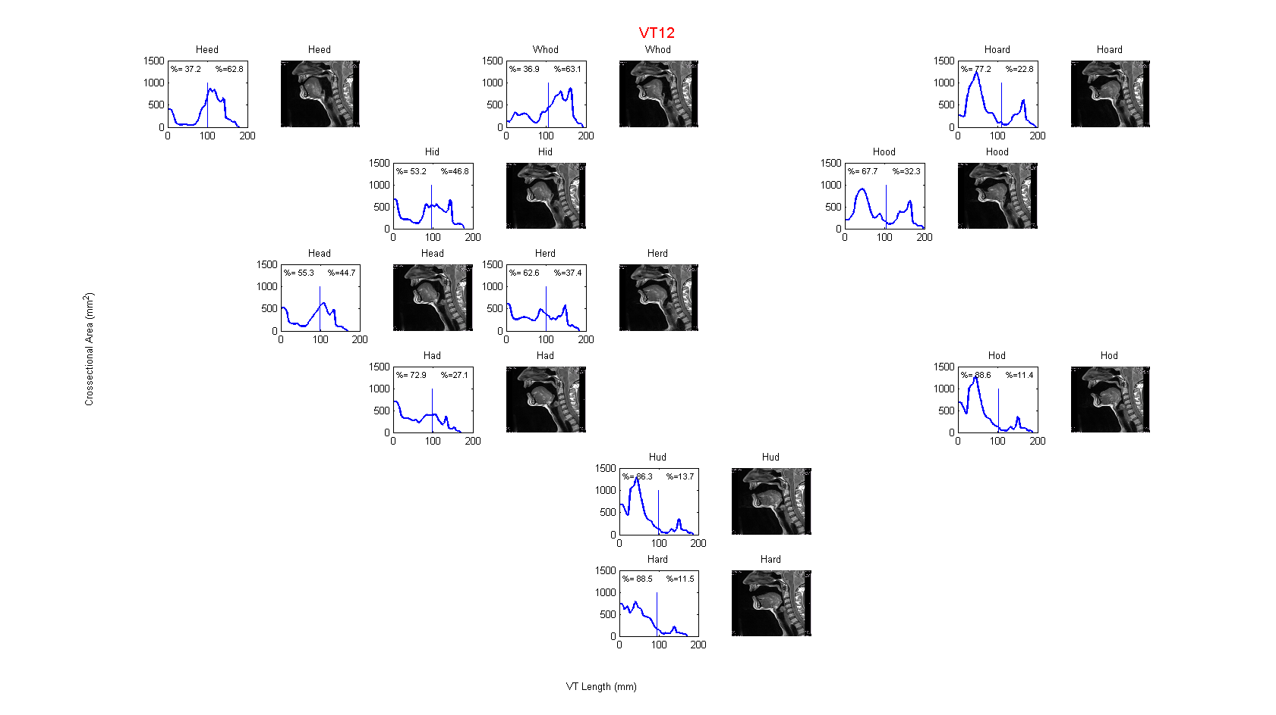

Slide 20
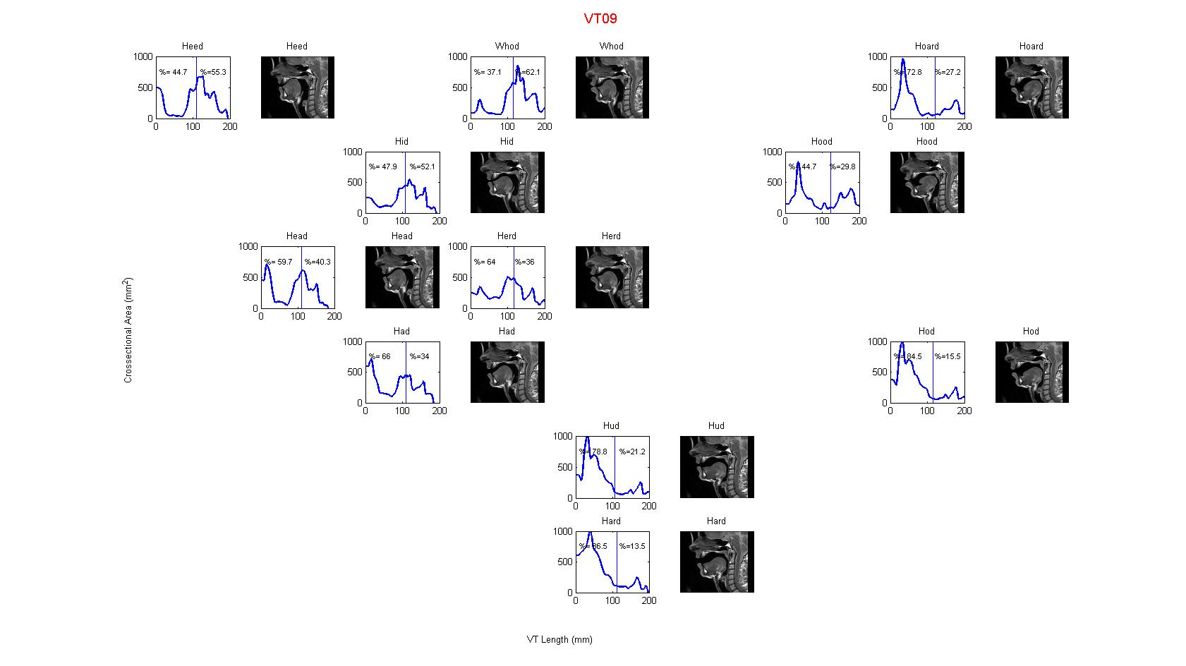

Slide 23
NZE vocal tract length analysis
Maximum length
Minimum length
Vocal tract length=distance from lips to glottis
Vocal tract lengths vary on a vowel by vowel basis
Maximum vocal tract length – lip rounded vowels –typically WHO’D or HOOD.
Minimum vocal tract length – open vowel – usually HAD or HARD
Those with phonetics/singing training had the largest range of vocal tract lengths.

Slide 24
American English vocal tract length analysis

Slide 25
NZE Oral Cavity Volume
(as a % of total volume)
Maximum
Minimum
Note can’t look at actual values, as can’t guarantee actual vocal effort same for each vowel
WHO’D has the lowest % volume in the oral cavity for all speakers with the except of VT06
The next lowest % volume in the oral cavity is HEED, followed by HID, for all speakers except
VT06, where its WHO’D followed by HEED.
The top four largest % volume in the oral cavity are HARD, HUD, HOD, and HOARD,
although the exact order changes for the different speakers.
The range of the smallest % oral cavity varied from 27% to 37%
The range of the largest % oral cavity varied from 68% to 87%.

Slide 26
American Eng. Oral Cavity Volume
(as a % of total volume)
American English Speakers:
  BS1:HEED,WHO’D,HID,HEAD,HERD,HOOD,HAD,HUD,HOARD,HOD
  BS2:HEED,HID,WHO’D,HEAD,HOOD,HAD,HUD,HOD,HOARD
  DJ: HEED,WHO’D,HID,HEAD,HAD,HOD,HUD,HOOD, HOARD
Australian English Speaker
  HEED, HID,WHO’D,HERD,HOOD,HEAD,HAD,HOARD,HUD,HARD,HOD

Slide 27
Comparison of mean NZE and Am E Vocal tract shape
% volume in oral cavity
44%
% volume in oral cavity
73%

